Slide 1






LOCAL AND REGIONAL PROCUREMENT
3. Introduction to Markets
LRP Market Monitoring Training

Slide 2
Why are markets important?
Markets are a part of everyone’s lives
Most people – especially the poor – rely on markets to provide food, essential goods and services
Markets also provide access to paid work and mechanisms for selling commodities and services
Strengthening markets can improve everyone’s lives and livelihoods
Harming markets can have serious negative impacts, particularly on the poor
Important to understand markets, so we know if our programs are strengthening or harming markets

Slide 3
What is a market?
Markets are composed of:
  Buyers
  Sellers
  Institutions and infrastructure
  Others behind the scenes: importers, processors, storage owners, wholesalers, credit suppliers, government officials and policies
Markets are where buyers and sellers come together to obtain information and exchange commodities.
A commodity is something tangible, that has value and can be exchanged.
A market chain includes all levels of the market and actors that have a role in the distribution and transformation of the commodity.

Slide 4
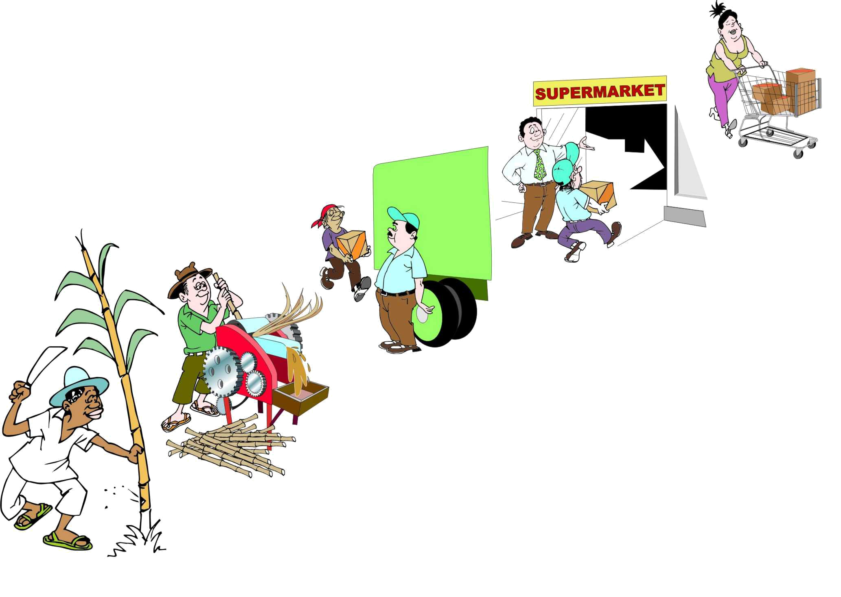
Customer
Retailer
Wholesaler
In a Market Chain commodities flow from producers to consumers
Processor
Farmer

Slide 5
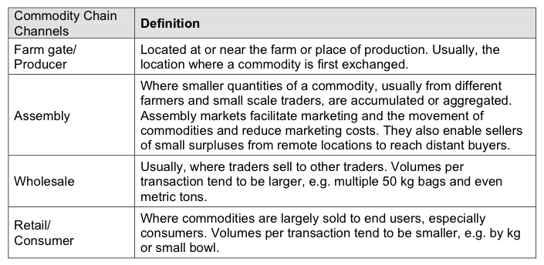
Types of Markets
Along a market chain, each trader buys and sells at different prices.
Source: FEWs (2008) Market Analysis and Assessment. Lesson 1, p. 5

Slide 6





The Market Chain
& Business Support Services
Consumption
Retailing
Trading
Research
Processing
Transportation
Govt. policy regulation
Trading
Communications
Post-harvest
handling
Production input supply
Tech. & business training & assistance
Production
Financial services
Market information and intelligence

Slide 7
Commodity Supply Chain
*USDA refers to wholesale prices as “producer prices.” USDA does not require the collection of farmgate prices.
Intermediary “wholesale” prices paid between brokers, aggregators, wholesalers
Farmgate
prices*
Retail prices

Slide 8
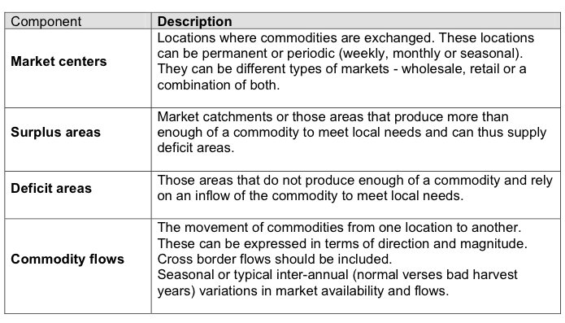
Market Definitions
Source: FEWs (2008) Market Analysis and Assessment. Lesson 1, p. 12

Slide 9
Market Characteristics and Efficiency
A market is said to be functioning well when goods flow into the market in times of deficit and out in times of surplus, via private trading.
A market is said to be functioning inefficiently when the costs of moving commodities in and out of markets are greater than the marginal profit received to do so.
Relative functioning of a market depends on:
  Number, size, independence of buyers and sellers
  Formation of prices
  Availability of information on prices and costs
  Ease of entry and exit
  Reliability of contract enforcement
  Integration across markets
  Institutional framework (infrastructure, government policies, etc)

Slide 10
Market Integration
Markets are integrated when price shocks from one geographic market are transmitted to other markets through the trading of goods.
When markets are integrated, the supply of food adjusts spatially to meet demands.
In integrated markets, an increase in prices due to a large local purchase of food would signal traders to bring in more supply, bringing prices back down.
If market integration is poor due to weak information and infrastructure and high transport and marketing costs, supply will not flow into the market, increasing prices for the population. In such cases, the local procurement of food can have significant effects on local prices.

Slide 11
Market Information
What is market information?
Who does market information help?
What effect does market information have on market efficiency and market integration?
Why is market information important to LRP projects?

Slide 12
References
Barrett, C. and E. Lentz (2010). Draft AEM 6940 MIFIRA Lecture Notes: Lecture 4.
CRS (2009). Linking Farmers to Markets. Module 1: Marketing Basics. Draft.
FEWs Net (2008) “Market Assessment and Analysis: Learners Notes.” FAO.

